Slide 1
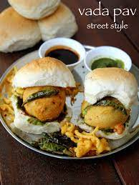
CASE STUDY -2

Slide 2
AGENDA
INTRODUCTION
PROBLEM STATEMENT AND DATA SCIENCE
OBJECTIVE AND METHODOLOGY
SOLUTION DESCRIPTION
IMPACT

Slide 3
INTRODUCTION
A new wada pav shop near Shivaji Nagar in Pune , have to be started.
Proper ideas and analysis should be done
Proper prices and varities of wada pav should start up.

Slide 4
PROBLEM STATEMENT AND DATA SCIENCE
A man wants to open a wada pav shop near Shivaji Nagar in pune. He has got a location where there are other 4 more wada pav shops. He is not able to understand what will be the strategy to take over his clients.
what will be the price of each wada paav?
How will he differentiate from the other competitors?
Why will you bring insights when he has no data of his shop?
Why will be the customer comes to your shop?(what will be the positioning)

Slide 5
OBJECTIVE AND METHODOLOGY
To set proper location for the business
To implement new ideas with the competitors
Put forth of new investments and trying new methods for the profit.

Slide 6
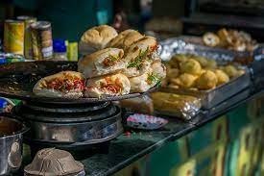
SOLUTION AND DESCRIPTION
Preferred place to open new wada pav shop at shivaji nagar can be near Wadewale , Shivajinagar ,as the rating of this center is just 2.5.
Cost of each plate of wada pav should be affordable and comparatively less at the beginning to step up with the new business.
As there are wada pav centres near by people choose the favourable one. So for the attraction try new things with offers and with much taste

Slide 7
IMPACT
hygiene should be given first preference, cost should be made lesser then other shops nearby in the beginning of the business, packaging and delivery needs to be taken care properly, positioning need to maintained to be appear like attractive, should be resistant to dust and smoke pollution, offerings with discounts for families and couples need to be given during weekends and special occasions.
price should be rs15/- as all other shops they costs rs20/- only for starting few of business once it got clicked then the price should be raised up to rs30/-
Service must be done with utmost discipline and timely delivery will be encouraged a lot, cleanliness need to be given preference and customer satisfaction will be given importance rather than making profits.
Packaging as well as serving must be done with much neat and attractive .

Slide 8

THE END
Yours faithfully
-ANUSHMA JOY N

